Slide 1
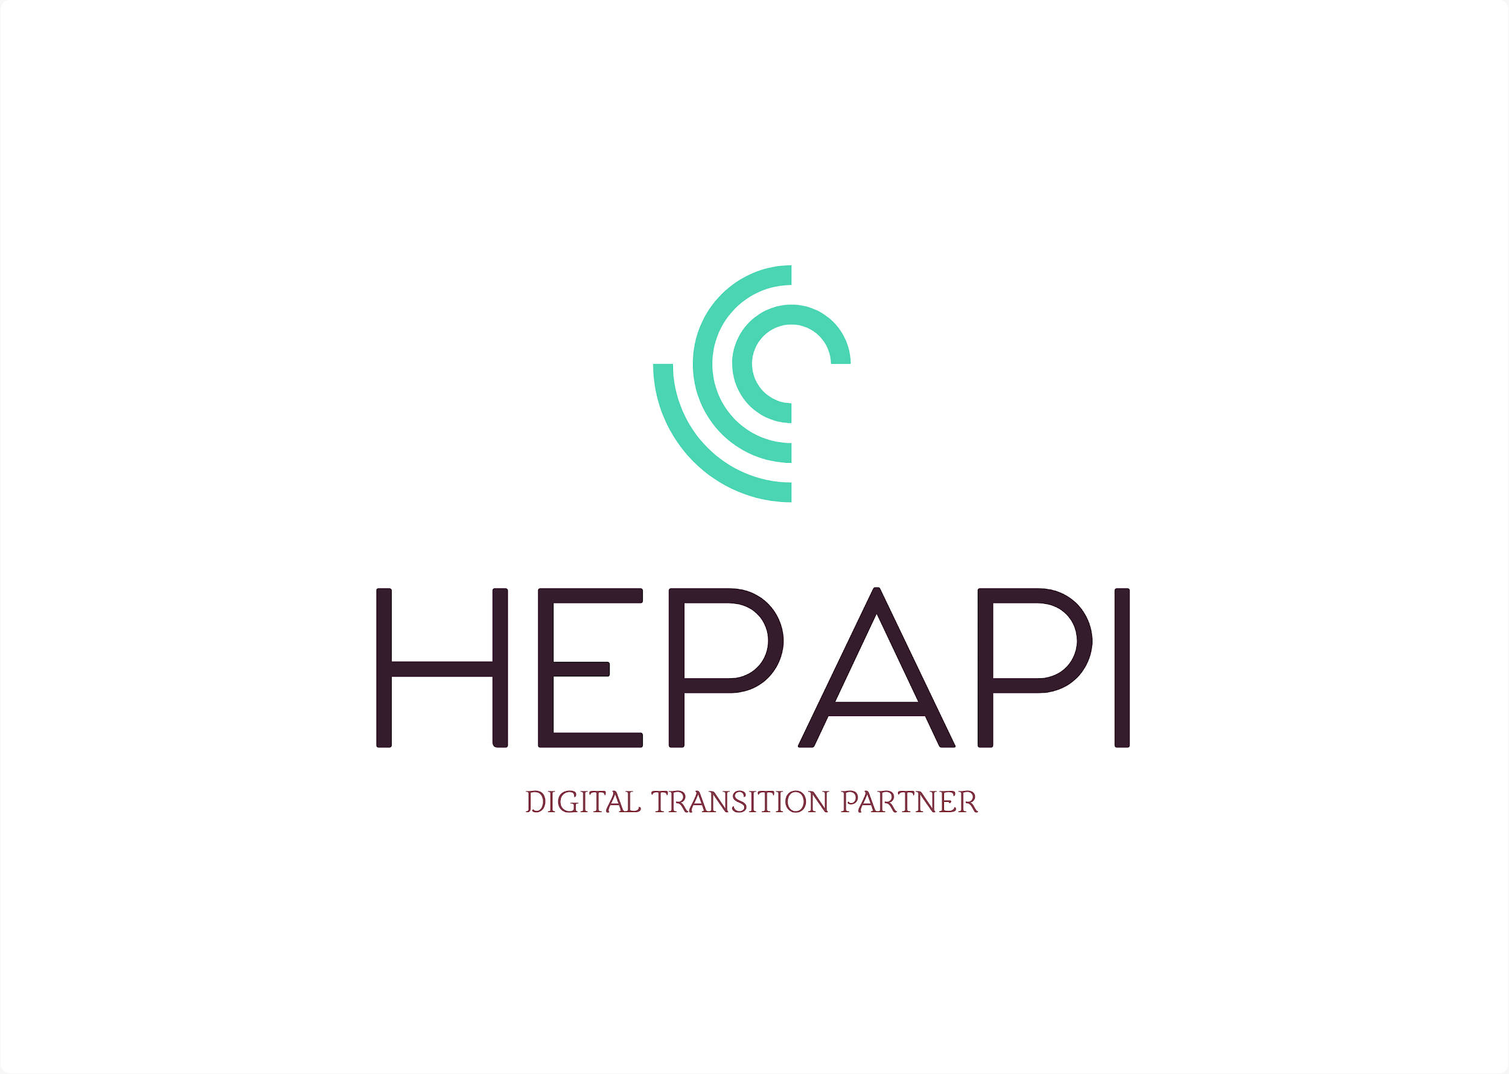
KUBERNETES

Slide 2
Introduction to Kubernetes
Orchestration
Kubernetes Components
Master Nodes Components
Worker Nodes Components
Setting Up Local Environment
Some kubectl commands

Slide 3
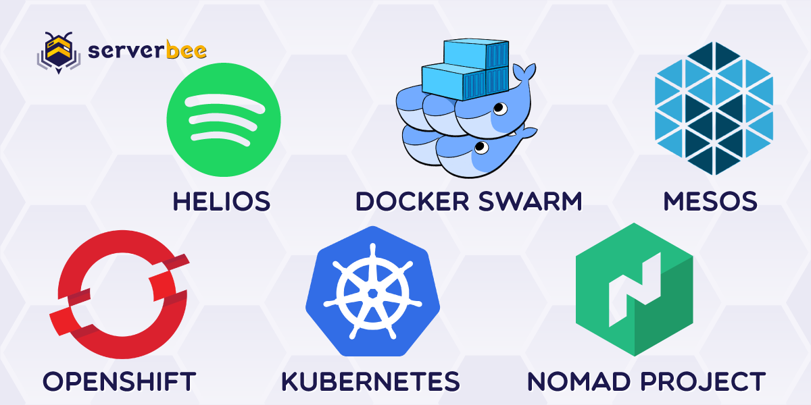
Kubernetes
Orchestration
Orchestration
Containers are great, but when you get lots of them running, at some point, you need them all working together in harmony to solve business problems.
Tools to manage, scale, and maintain containerized applications are called orchestrators, and the most common example of this is Kubernetes.

Slide 4
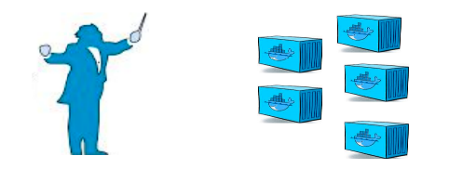
Kubernetes
Orchestration
Container orchestration is used to automate the following tasks at scale:
Provisioning and deployments of containers
Availability of containers
Load balancing, traffic routing and service discovery of containers
Health monitoring of containers
Securing the interactions between containers.
Configuring and scheduling of containers
Allocation of resources between containers

Slide 5
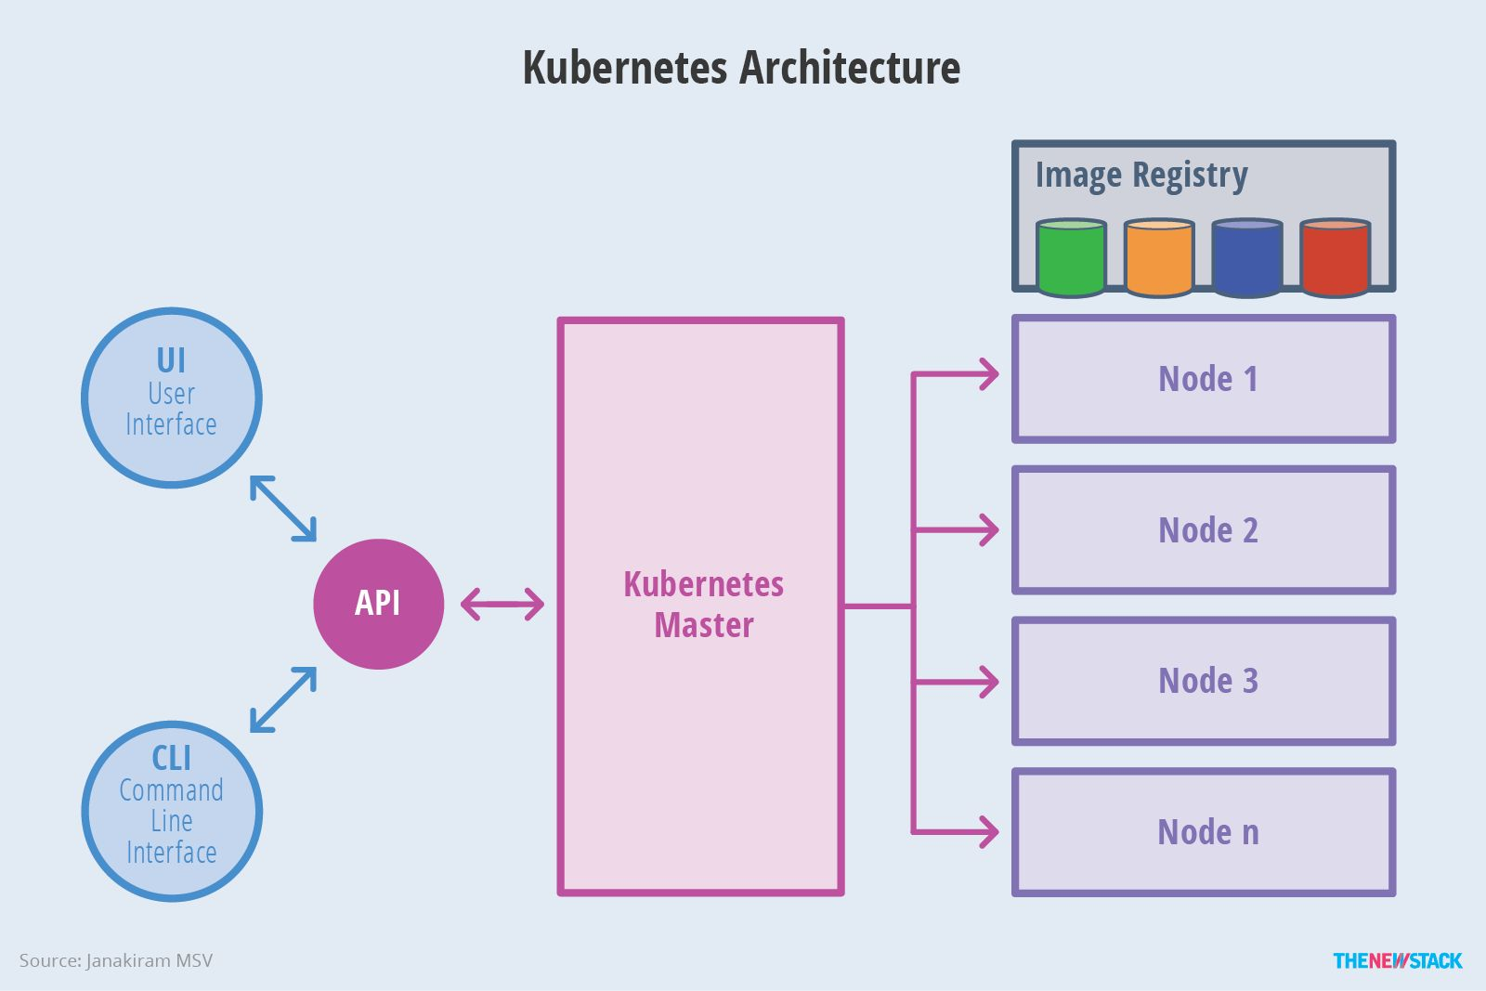
Kubernetes
Kubernetes Components
Kubernetes has the following main components:
• One or more master nodes
• One or more worker nodes.

Slide 6
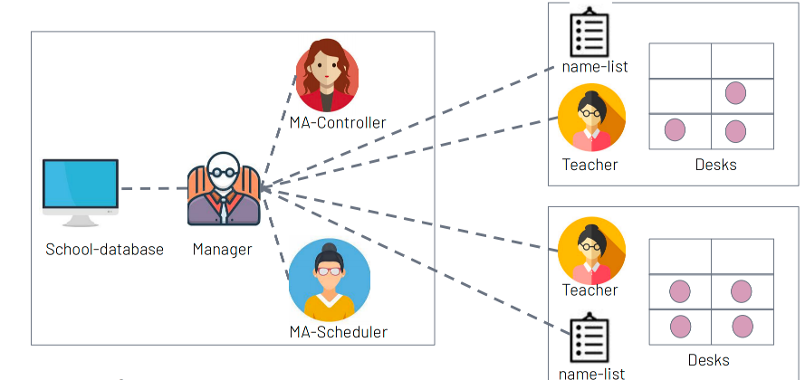
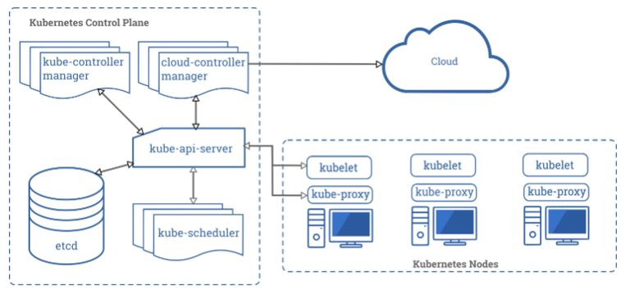
Kubernetes
Kubernetes Components

Slide 7
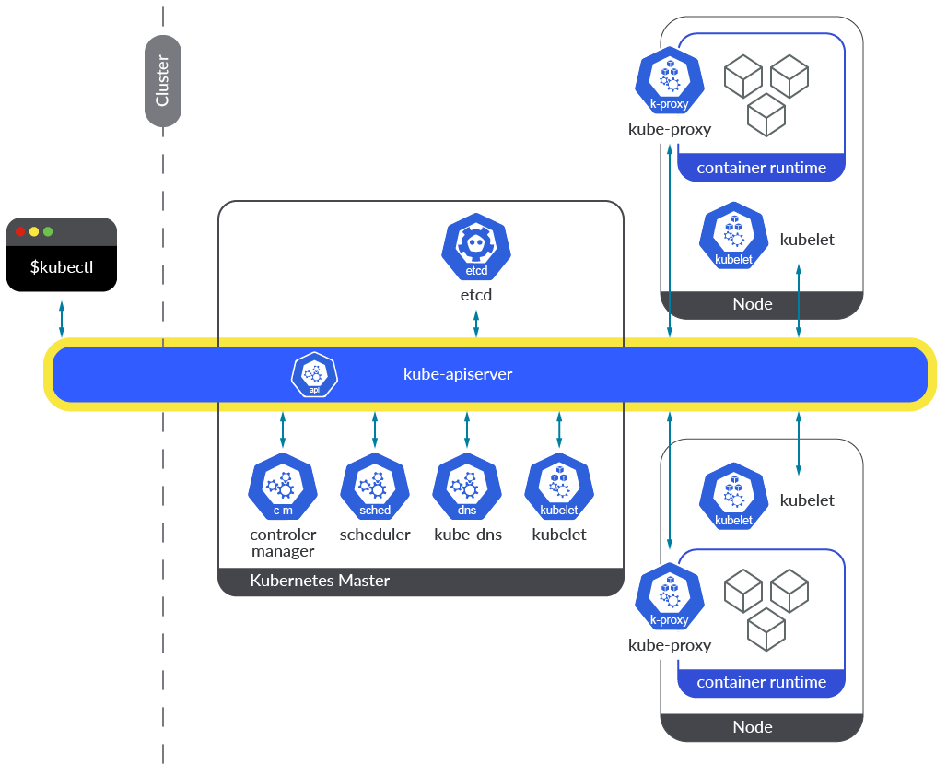
Kubernetes
Kubernetes Master Node Components
Kube Api Server:
Acts as the front end for the Kubernetes control plane
Exposes the Kubernetes API
Handles communication between all other components
Responsible for authentication and authorization

Slide 8
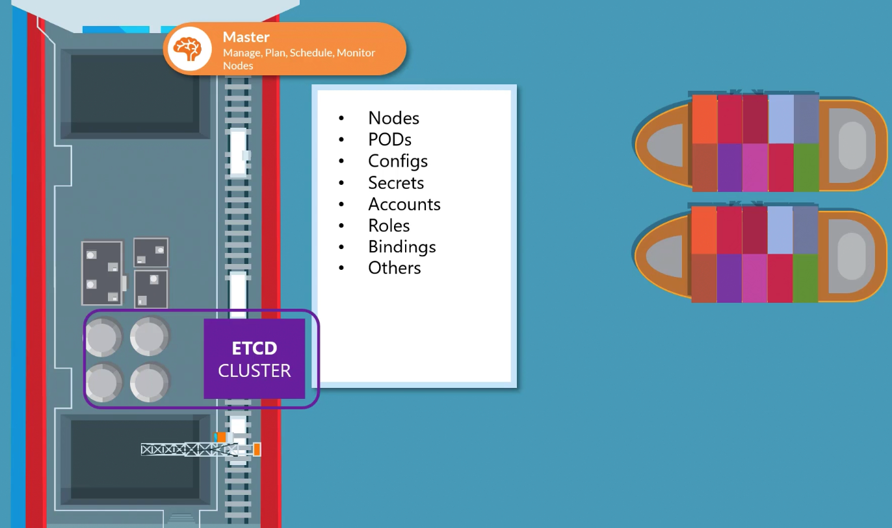
Kubernetes
Kubernetes Master Node Components
ETCD:
Distributed key-value store
Stores all cluster data
Ensures data consistency and availability
Critical for Kubernetes cluster operation
Can be inside or outside the cluster

Slide 9
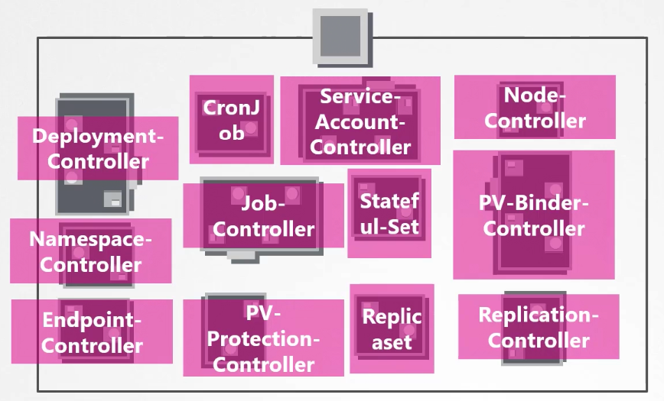
Kubernetes
Kubernetes Master Node Components
Kube Controller Manager:
Watch status and Remediate Situation
Node Controller: Handles node failures
Replication Controller: Maintains the desired number of pod replicas
Endpoint Controller: Manages endpoints in services
Service Account & Token Controllers: Create default accounts and API access tokens

Slide 10
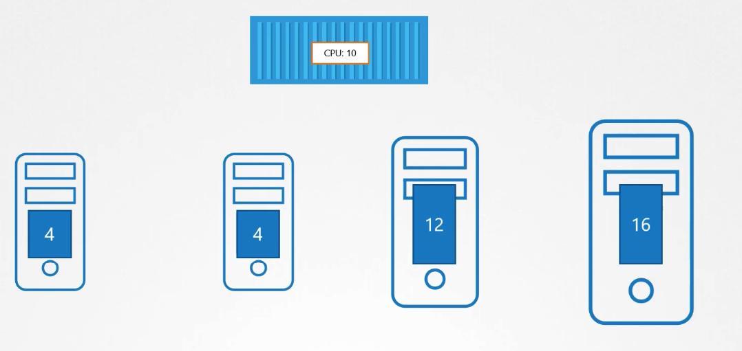
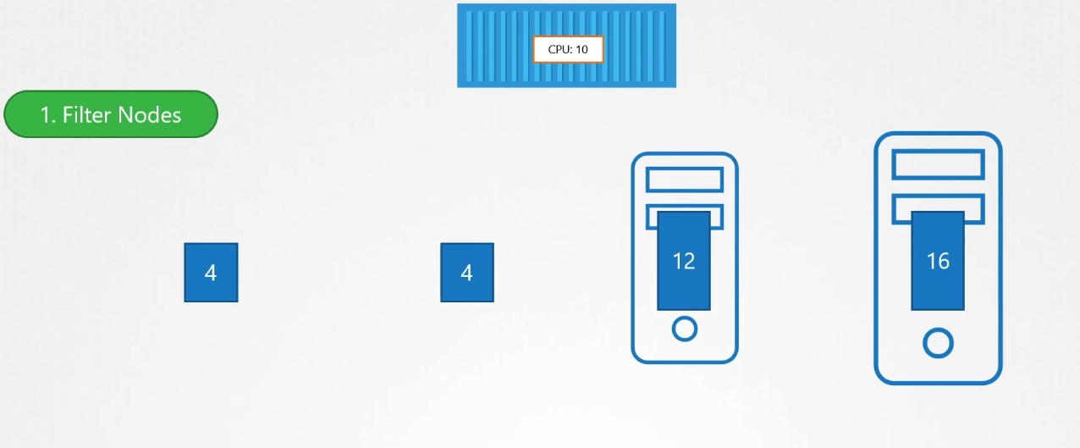
Kubernetes
Kubernetes Master Node Components
Kube Scheduler:
Responsible for scheduling pods on nodes
Evaluates resource requirement
Considers policy constraints, affinity/anti-affinity specifications
Ensures efficient utilization of resources

Slide 11
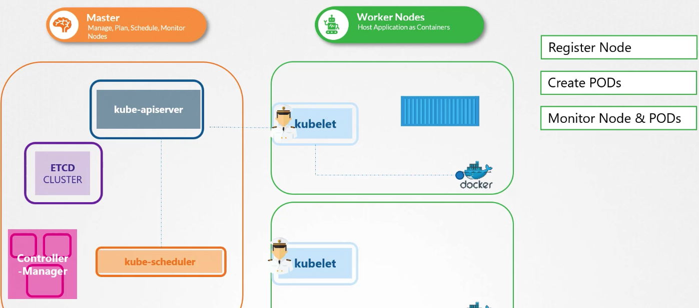
Kubernetes
Kubernetes Worker Node Components
Kubelet:
Agent that runs on each node
Ensures containers are running in a pod
Communicates with the kube-apiserver
Monitors pod status and reports to the control plane

Slide 12
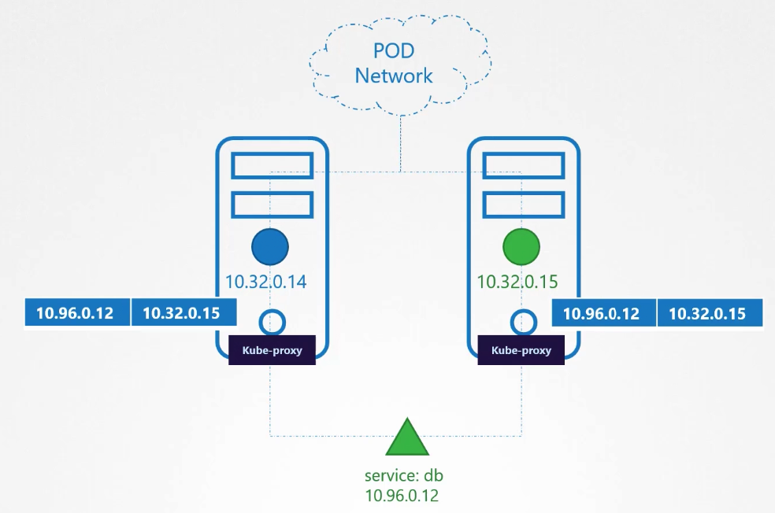
Kubernetes
Kubernetes Worker Node Components
Kube Proxy:
Manages network connectivity and traffic routing
Implements Service abstraction
Handles request forwarding to the correct pod
Ensures load balancing and network rules

Slide 13
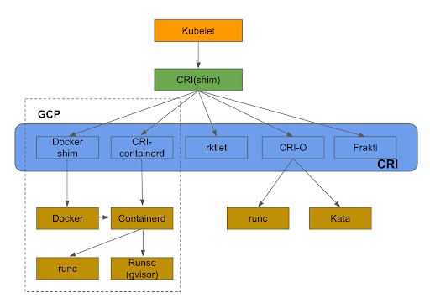
Kubernetes
Kubernetes Worker Node Components
Container Runtime:
Software responsible for running containers
Common runtimes: Docker, containerd, CRI-O
Manages container lifecycle: creation, execution, and termination
Interfaces with kubelet for container operations

Slide 14
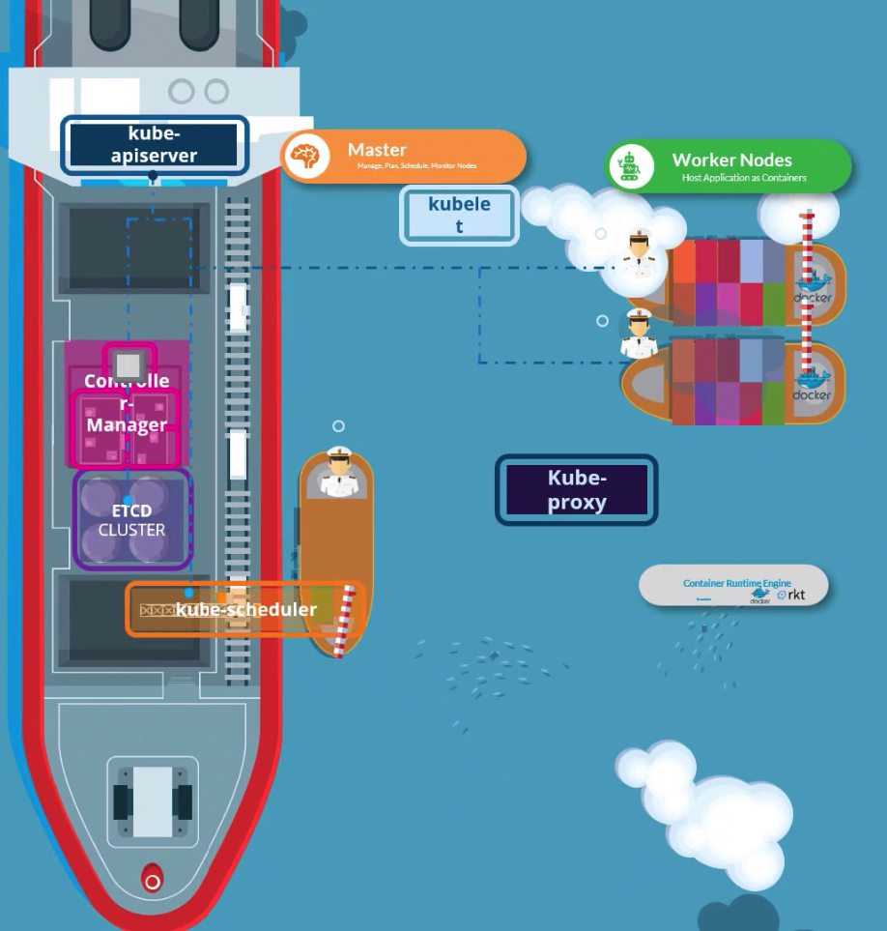
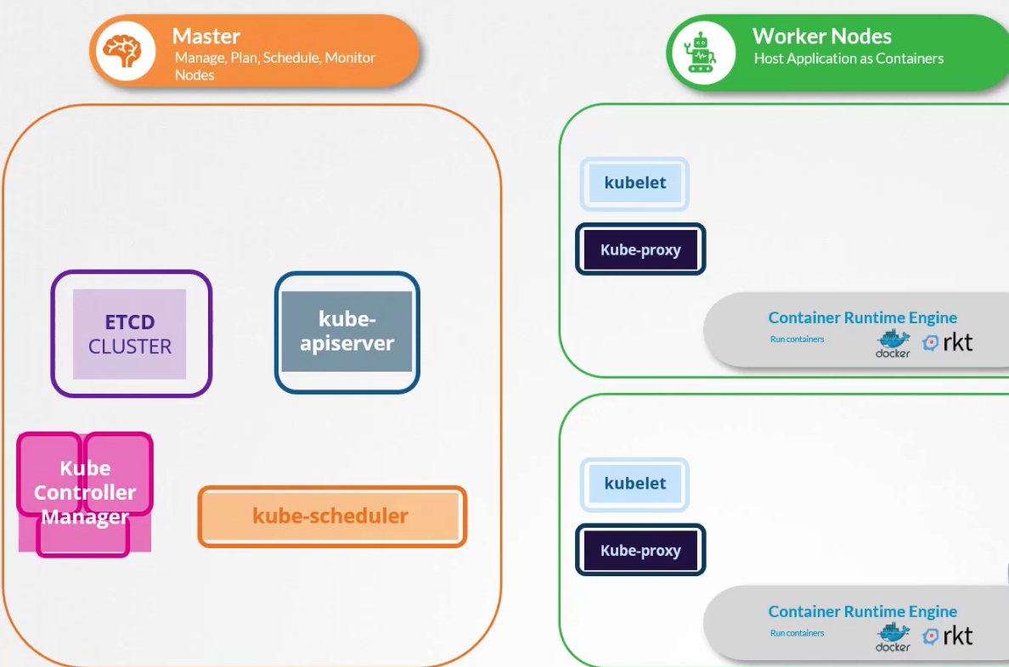
Kubernetes
Kubernetes Components

Slide 15
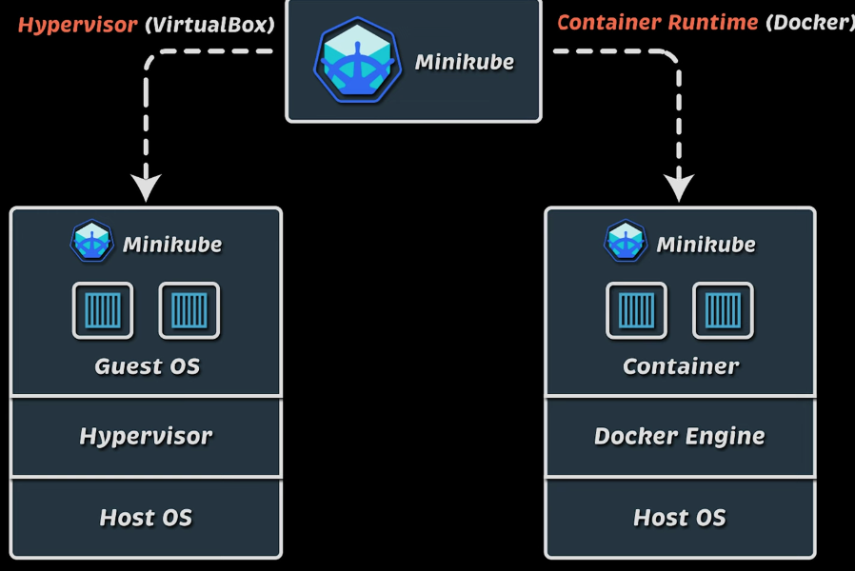
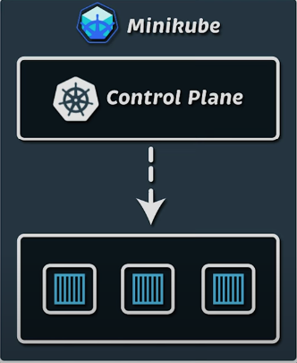
Setting Up Local Environment

Slide 16
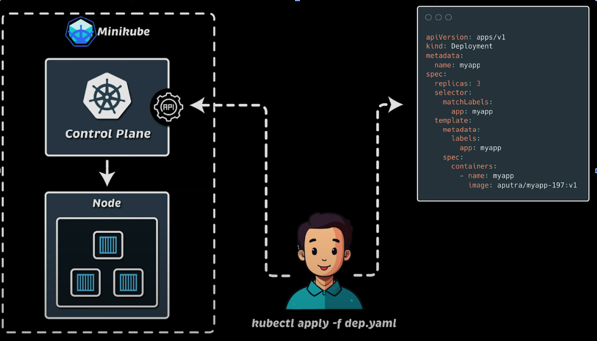
Setting Up Local Environment

Slide 17
KUBERNETES Objects
▶ Object Model
▶ PODs
▶ ReplicaSets
▶ Deployment
▶ Namespaces

Slide 18
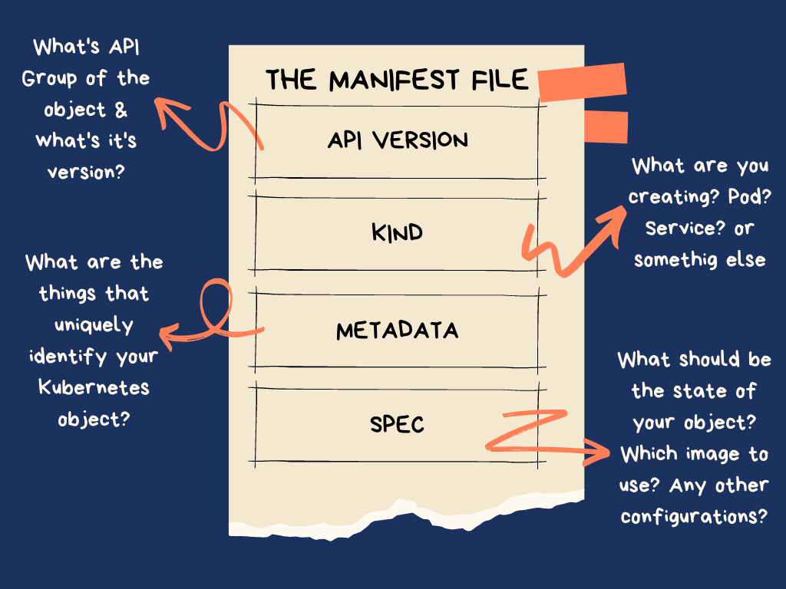
Kubernetes Objects
Object Model

Slide 19
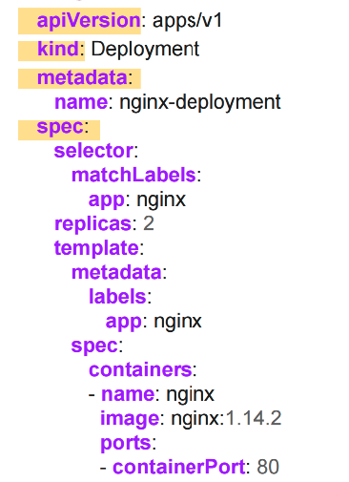
Kubernetes Objects
Object Model
All objects must have apiVersion, kind, metadata and spec fields.
apiVersion: Which version of the Kubernetes API you're using to create this object
kind: What kind of object you want to create
metadata: Data that helps uniquely identify the object, including a name string, labels, and optional namespace
spec: What state you desire for the object

Slide 20
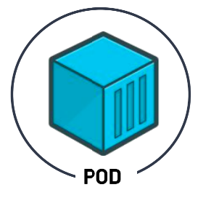
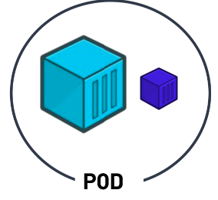
Kubernetes Objects
Pods
Kubernetes doesn't deal with containers directly.
PODs are Kubernetes objects that encapsulate the containers.
Pods are the smallest deployable units of computing that you can create and manage in Kubernetes.
A POD can have multiple containers.
Sometimes an application need a helper container, such as logging, monitoring, etc.
These helper containers should coexist with your application container.

Slide 21
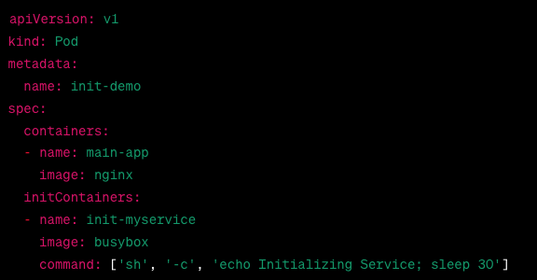
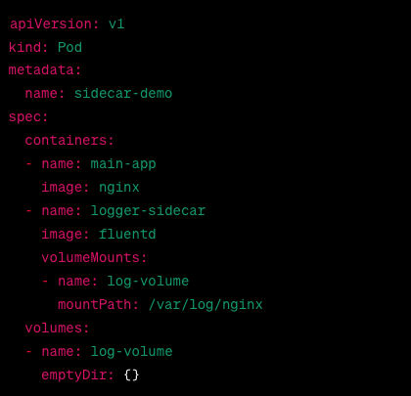
Kubernetes Objects
Pods

Slide 22
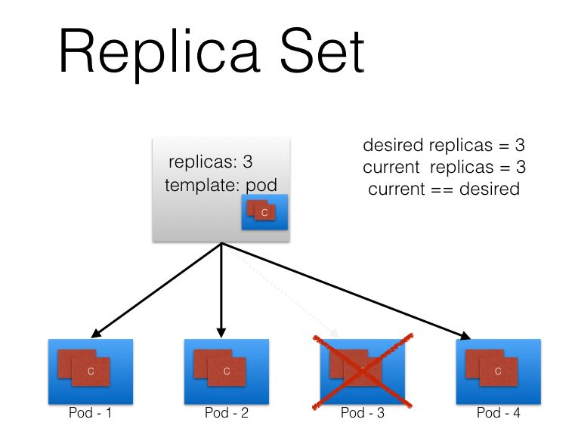
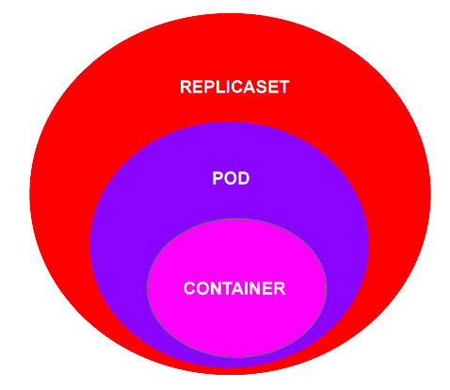
Kubernetes Objects
ReplicaSets
A ReplicaSet's purpose is to maintain a stable set of replica Pods running at any given time.
Even if you have a single POD, the ReplicaSet will bring up a new POD when the existing one fails.

Slide 23
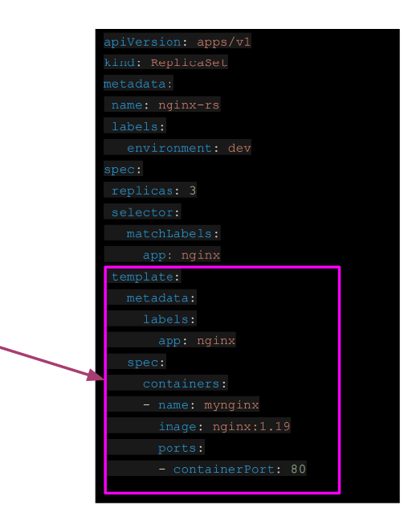
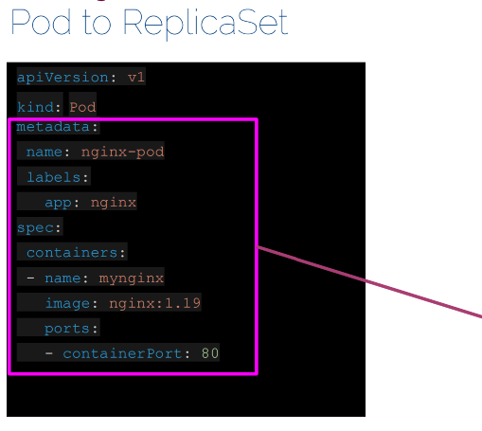
Kubernetes Objects
ReplicaSets

Slide 24
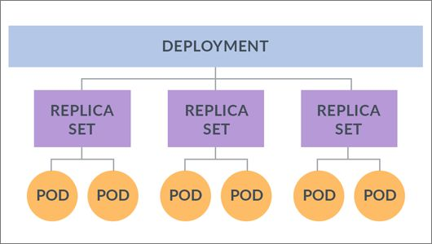
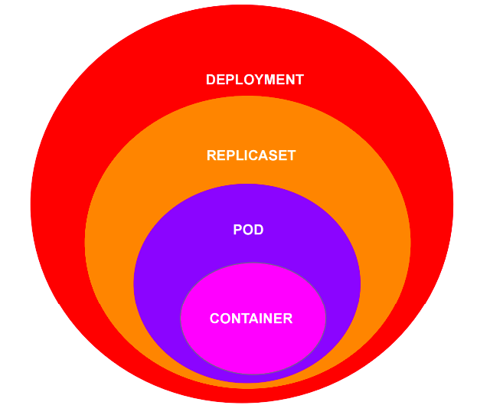
Kubernetes Objects
Deployment
One step higher in the hierarchy, deployments provides declarative updates for Pods and ReplicaSets.

Slide 25
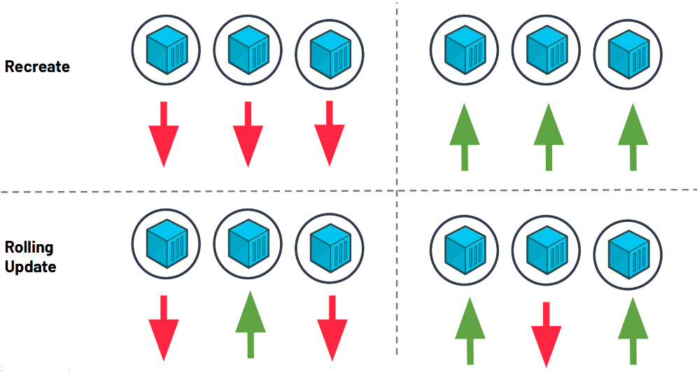
Kubernetes Objects
Deployment Strategy

Slide 26
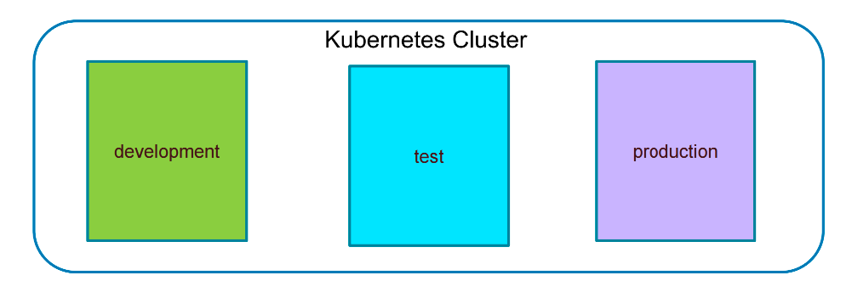
Kubernetes Objects
Namespaces
Kubernetes supports multiple virtual clusters backed by the same physical cluster. These virtual clusters are called namespaces.
Namespaces are intended for use in environments with many users spread across multiple teams, or projects.

Slide 27
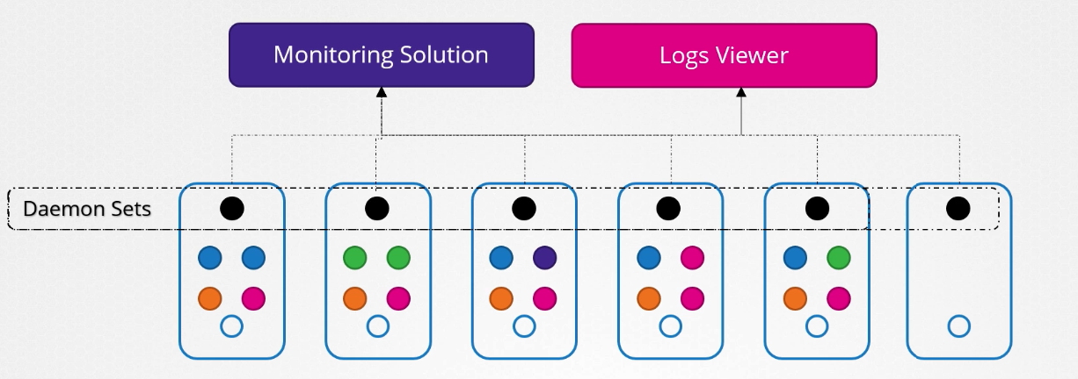
Kubernetes Objects
Daemonsets
DaemonSets ensure that a copy of a Pod runs on all or some Nodes in the cluster. They are typically used for:
Log Collection: Running log collection daemons like Fluentd or Logstash on every Node.
Monitoring: Deploying monitoring agents like Prometheus Node Exporter or Datadog Agent on each Node.
Networking: Running network proxies or VPN daemons across the cluster.

Slide 28
Kubernetes Objects
Jobs
Kubernetes Jobs are used to run tasks that need to be completed once or a specific number of times. They are essential for:
Batch Processing: Running batch processing tasks like data processing or file conversions.
One-Time Tasks: Executing scripts or commands that need to run once.
Retry Mechanism: Ensuring tasks are retried upon failure until successful completion.

Slide 29
KUBERNETES Networking
▶ Cluster Networking
▶ Services
▶ Service Types
▶ Ingress

Slide 30
Kubernetes Networking
Cluster Networking
There are 4 distinct networking problems to address:
1. container-to-container communications:
2. Pod-to-Pod communications:
3. Pod-to-Service communications: this is covered by services.
4. External-to-Service communications: this is covered by services.

Slide 31
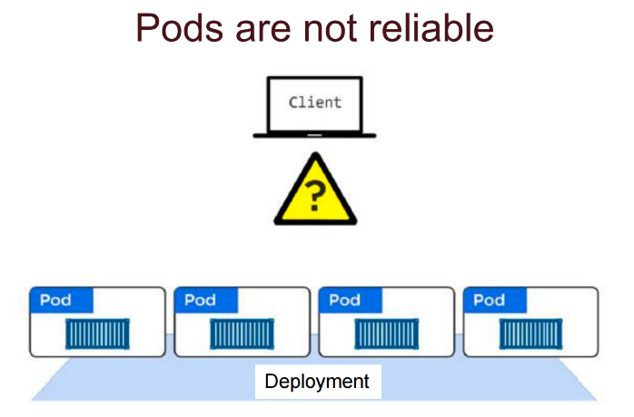
Kubernetes Networking
Services

Slide 32
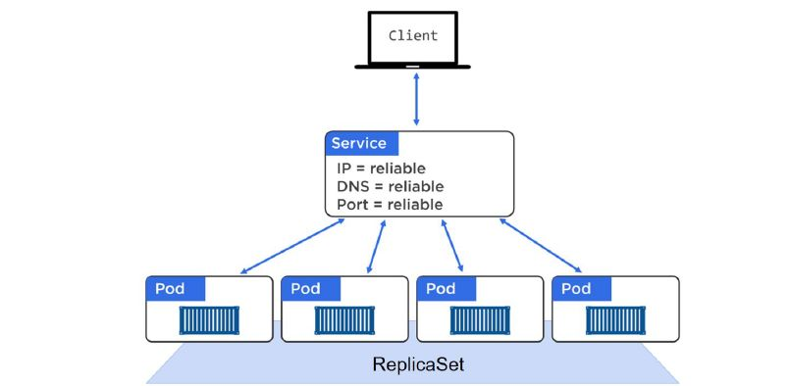
Kubernetes Networking
Services
A Service offers a single DNS entry for a containerized application managed by the Kubernetes cluster
The Service is associated with the Pods, and provides them with a stable IP, DNS and port. It also loadbalances requests across the Pods.

Slide 33
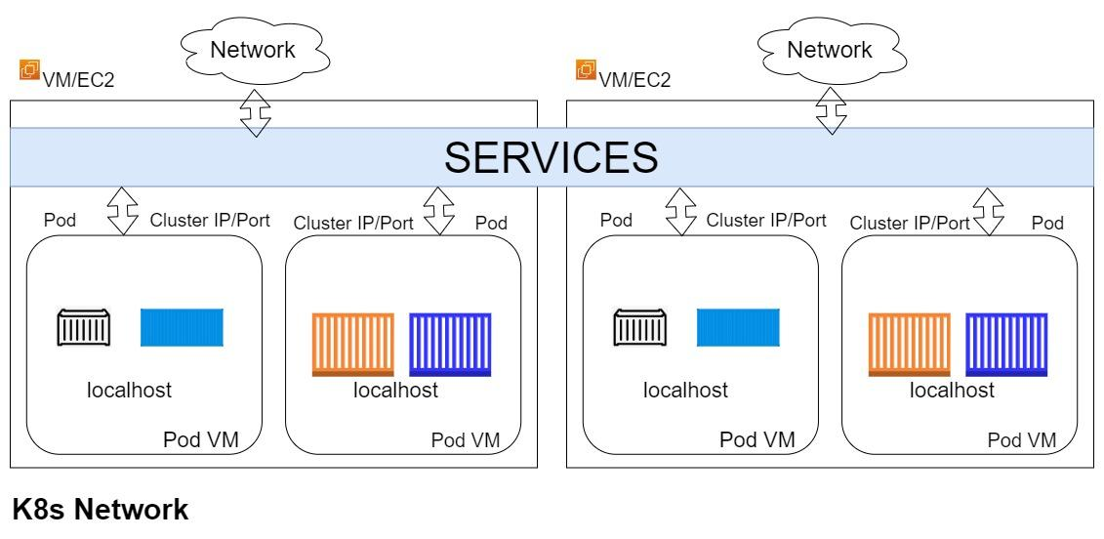
Kubernetes Networking
Services

Slide 34
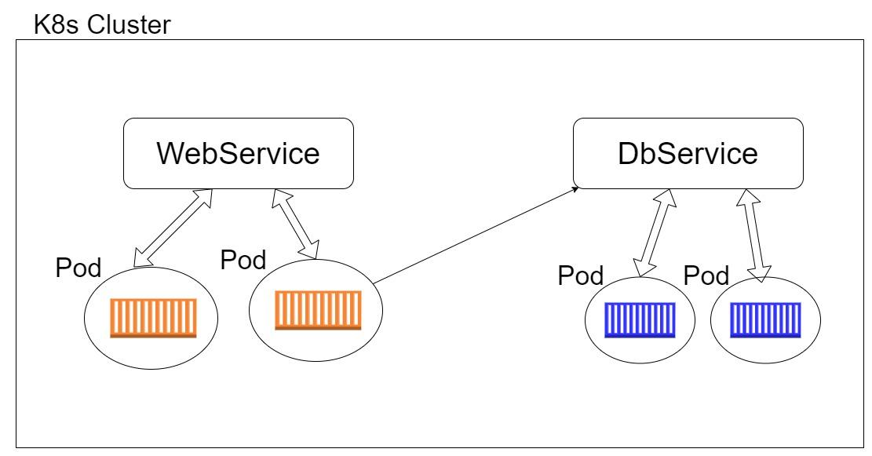
Kubernetes Networking
Services

Slide 35
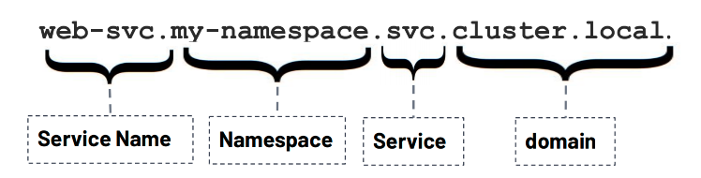
Kubernetes Networking
Services Discovery
Kubernetes has an add-on for DNS, which creates a DNS record for each Service and its format is

Slide 36
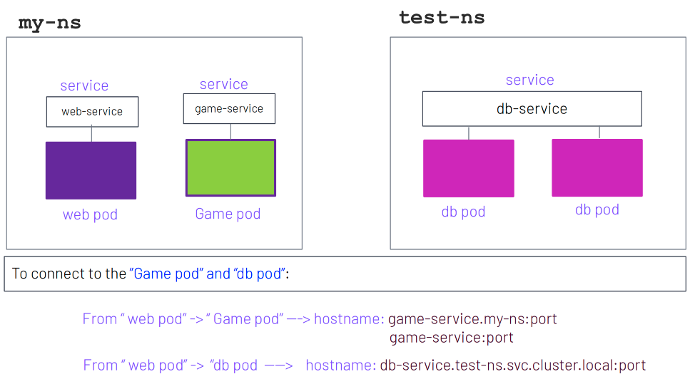
Kubernetes Networking
Services Discovery

Slide 37
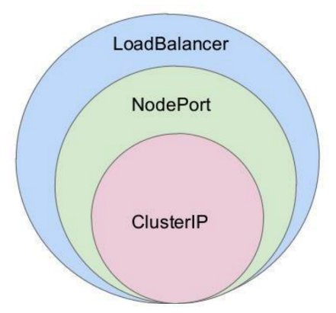
Kubernetes Networking
Services Types
There are 3 major service types:
• ClusterIP (default)
• NodePort
• LoadBalancer

Slide 38
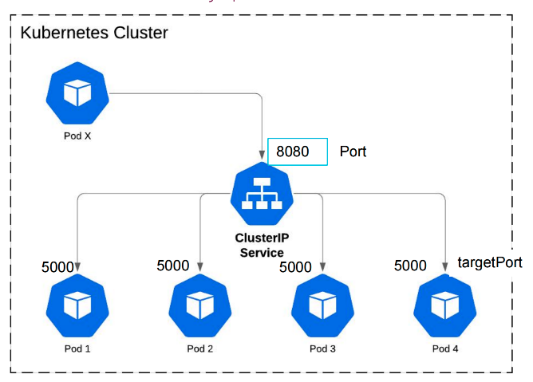
Kubernetes Networking
ClusterIP
Expose traffic internally
Example Usecase:
Good for service of frontend & back-end apps.

Slide 39
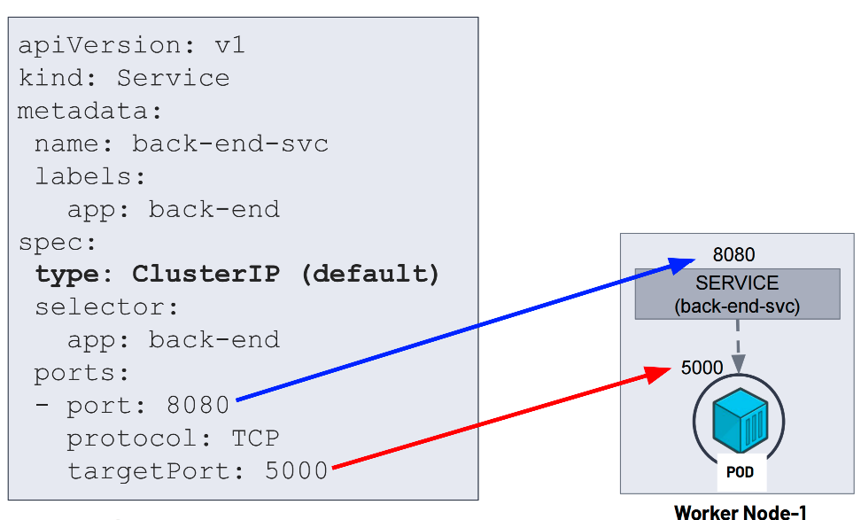
Kubernetes Networking
ClusterIP

Slide 40
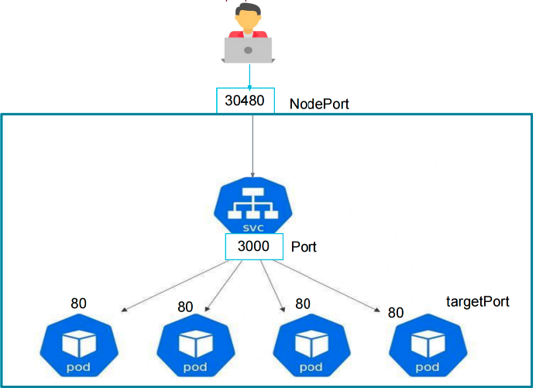
Kubernetes Networking
NodePort
Exposes traffic to the outside.
Example Use Case:
when we want to make our Services which has our app or website accessible from the
external world.

Slide 41
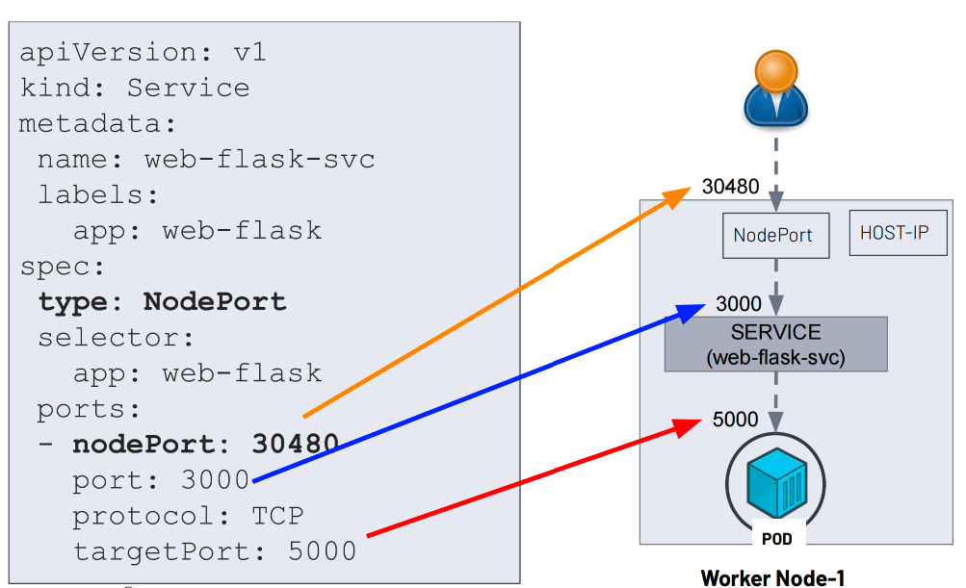
Kubernetes Networking
NodePort

Slide 42
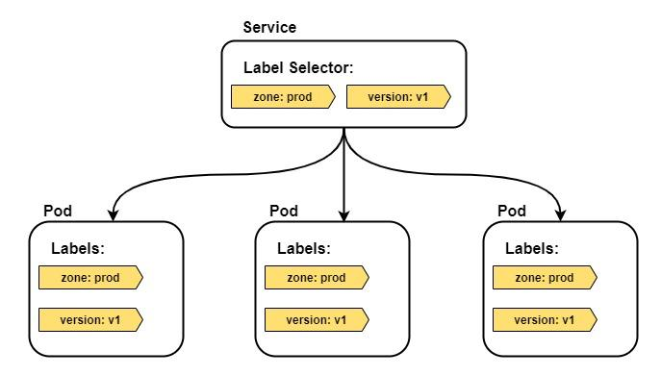
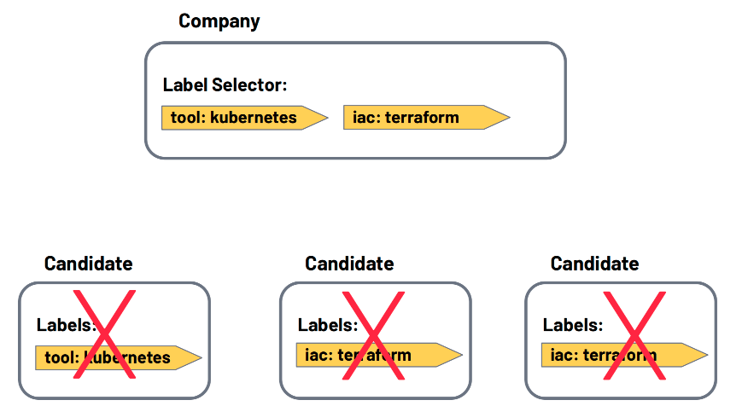
Kubernetes Networking
Labels and loose coupling

Slide 43
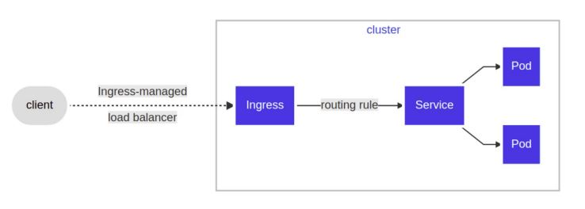
Kubernetes Networking
Ingress:With Ingress, users do not connect directly to a Service. Users reach the Ingress endpoint, and, from there, the request is forwarded to the desired Service.

Slide 44
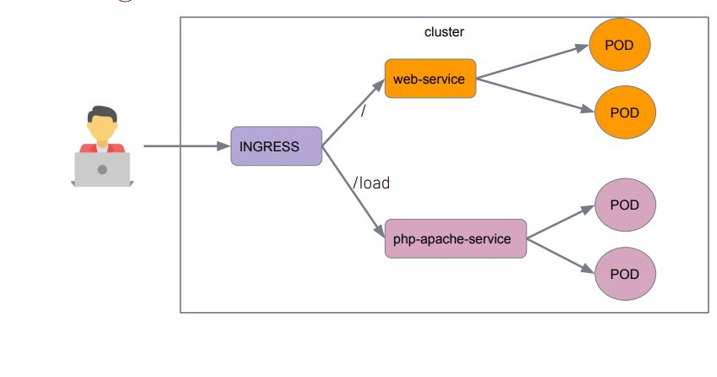
Kubernetes Networking
Ingress

Slide 45
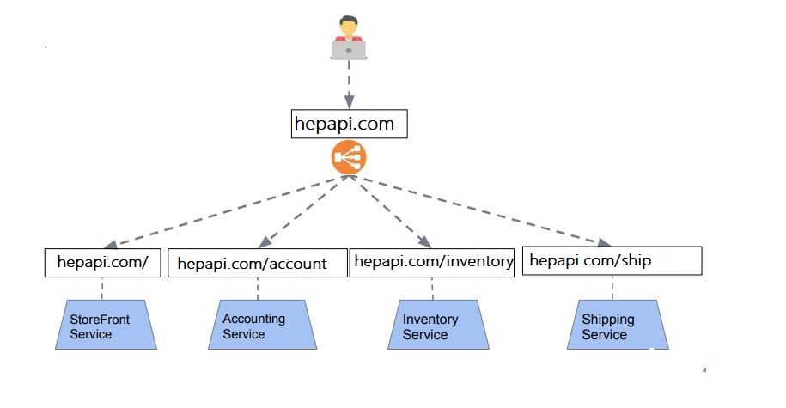
Kubernetes Networking
Ingress:exposes HTTP and HTTPS routes from outside the cluster to services within the cluster.

Slide 46
Secrets and Configmaps

Slide 47

ConfigMap
ConfigMap is an API object used to store non-confidential data in key-value pairs. Pods can consume ConfigMaps as environment variables, command-line arguments, or as configuration files in a volume.

Slide 48

ConfigMap
A ConfigMap allows you to decouple environment-specific configuration from your container images, so that your applications are easily portable.

Slide 49

Secrets
A Secret is an object that contains a small amount of sensitive data such as a password, a token, or a key. Such information might otherwise be put in a Pod specification or in an image.

Slide 50

Secrets
Opaque is the default Secret type if omitted from a Secret configuration file. When you create a Secret using kubectl, you will use the generic subcommand to indicate an Opaque Secret type.

Slide 51

Secrets
Secrets can be mounted as data volumes or exposed as environment variables to be used by a container in a Pod.

Slide 52

ConfigMap and Secret

Slide 53

ConfigMap and Secret

Slide 54
KUBERNETES Storage
▶ Volumes
▶ Volume Types
▶ PersistentVolume & PersistentVolumeClaim
▶ ▶ StorageClass

Slide 55


Volumes
All data stored inside a container is deleted if the container crashes
When a Container crashes, kubelet will restart it, but the files will be lost which means that it will not have any of the old data.
To overcome this problem, Kubernetes uses Volumes. A Volume is essentially a directory backed by a storage medium. The storage medium, content and access mode are determined by the Volume Type.

Slide 56

Volume Types
hostPath: A hostPath volume mounts a file or directory from the host node's file system into your Pod.

Slide 57

Volume Types
emptyDir: An emptyDir volume is first created when a Pod is assigned to a Node and exists as long as that Pod is running on that node.
Some uses for an emptyDir are:
checkpointing a long computation for recovery from crashes
as a cache

Slide 58

Volume Types
hostPath vs emptyDir

Slide 59
Volume Types
Kubernetes provides several storage plugins that provide access to storage devices deployed in a Kubernetes cluster. These are implemented using the StorageClass object.
Some of the main plugins currently supported by Kubernetes are GCEPersistentDisk, AWSElasticBlockStore, AzureDisk, Glusterfs, NFS, and iSCSI.
AWS Elastic Block Store: An awsElasticBlockStore volume mounts an Amazon Web Services (AWS) EBS Volume into your Pod.
Azure Disk: An azureDisk is used to mount a Microsoft Azure Data Disk into a Pod.
GCE Persistent Disk: A gcePersistentDisk volume mounts a Google Compute Engine (GCE) persistent disk (PD) into your Pod

Slide 60

Volume Types
NFS:Network File System (NFS) is a standard protocol for mounting storage devices as local drives. Kubernetes lets you mount an NFS volume as a local drive in a container. Because legacy code often accesses data via NFS, this plugin is very useful for migrating legacy workloads to Kubernetes.

Slide 61

Volume Types
Longhorn is an open-source distributed block storage system designed for Kubernetes. It provides persistent storage for containerized applications running on Kubernetes clusters..Longhorn supports volume snapshots, allowing you to capture the state of a volume at a specific point in time. It also provides backup functionality for disaster recovery purposes.Longhorn uses synchronous replication to ensure that data is stored on multiple nodes, providing high availability. If one node fails, the data is still accessible from replicas on other nodes.

Slide 62

PersistentVolume
A PersistentVolume (PV) is a piece of storage in the cluster that has been provisioned by an administrator or dynamically provisioned using Storage Classes

Slide 63
PersistentVolumeClaim
A PersistentVolumeClaim (PVC) is a request for storage by a user. Users request for PersistentVolume resources based on type, access mode, and size. There are four access modes:
ReadWriteOnce (read-write by a single node)
ReadOnlyMany (read-only by many nodes)
ReadWriteMany (read-write by many nodes).
ReadWriteOncePod (read-write only one pod in the cluster)
Once a suitable PersistentVolume is found, it is bound to a PersistentVolumeClaim.

Slide 64

PersistentVolumeClaim

Slide 65
StorageClass
Provisioning: There are two ways PVs may be provisioned; statically or dynamically.
Static: A cluster administrator creates a number of PVs. They carry the details of the real storage, which is available for use by cluster users. They exist in the Kubernetes API and are available for consumption.
Dynamic: When none of the static PVs the administrator created match a user's PersistentVolumeClaim, the cluster may try to dynamically provision a volume specially for the PVC. This provisioning is based on StorageClasses.

Slide 66

StorageClass
StorageClass: provides a way for administrators to describe the "classes" of storage they offer.

Slide 67

StorageClass

Slide 68
KUBERNETES Security
▶ Network Policy
▶ Service Account
▶ Role,ClusterRole
▶ ▶ RoleBindings,ClusterRoleBindings
▶ ▶ Resource Request and Limit
▶ Horizontal Pod Autoscaller(HPA)

Slide 69
Network Policy
Network Policies are a mechanism for controlling network traffic flow in Kubernetes clusters. They allow you to define which of your Pods are allowed to exchange network traffic. You should use them in your clusters to prevent apps from reaching each other over the network, which will help limit the damage if one of your apps is compromised.
There are three different ways to identify target endpoints:
Specific Pods (Pods matching a label are allowed)
Specific Namespaces (all Pods in the namespace are allowed)
IP address blocks (endpoints with an IP address in the block are allowed)

Slide 70

Network Policy

Slide 71
Service Account
Whenever you access your Kubernetes cluster with kubectl, you are authenticated by Kubernetes with your user account. User accounts are meant to be used by humans. But when a pod running in the cluster wants to access the Kubernetes API server, it needs to use a service account instead. Service accounts are just like user accounts but for non-humans.
Default service accounts
When you create a cluster, Kubernetes automatically creates a ServiceAccount object named default for every namespace in your cluster. The default service accounts in each namespace get no permissions by default other than the default API discovery permissions that Kubernetes grants to all authenticated principals if role-based access control (RBAC) is enabled. If you delete the default ServiceAccount object in a namespace, the control plane replaces it with a new one.

Slide 72
Role, ClusterRole
An RBAC Role or ClusterRole contains rules that represent a set of permissions. Permissions are purely additive (there are no "deny" rules).A Role always sets permissions within a particular namespace; when you create a Role, you have to specify the namespace it belongs in.ClusterRole, by contrast, is a non-namespaced resource. The resources have different names (Role and ClusterRole) because a Kubernetes object always has to be either namespaced or not namespaced; it can't be both.
ClusterRoles have several uses. You can use a ClusterRole to:
define permissions on namespaced resources and be granted access within individual namespace(s)
define permissions on namespaced resources and be granted access across all namespaces
define permissions on cluster-scoped resources

Slide 73
RoleBinding-ClusterRoleBinding
A role binding grants the permissions defined in a role to a user or set of users. It holds a list of subjects (users, groups, or service accounts), and a reference to the role being granted. A RoleBinding grants permissions within a specific namespace whereas a ClusterRoleBinding grants that access cluster-wide.
A RoleBinding may reference any Role in the same namespace. Alternatively, a RoleBinding can reference a ClusterRole and bind that ClusterRole to the namespace of the RoleBinding. If you want to bind a ClusterRole to all the namespaces in your cluster, you use a ClusterRoleBinding.

Slide 74

RoleBinding-ClusterRoleBinding

Slide 75

Resource Request and Limit
Kubernetes defines requests as a guaranteed minimum amount of a resource to be used by a container.
Basically, it will set the minimum amount of the resource for the container to consume.
When a Pod is scheduled, kube-scheduler will check the Kubernetes requests in order to allocate it to a particular Node that can satisfy at least that amount for all containers in the Pod. If the requested amount is higher than the available resource, the Pod will not be scheduled and remain in Pending status.

Slide 76

Resource Request and Limit
Kubernetes defines limits as a maximum amount of a resource to be used by a container.
This means that the container can never consume more than the memory amount or CPU amount indicated.
When allocating Pods to a Node. If no requests are set, by default, Kubernetes will assign requests = limits.
At runtime, Kubernetes will check that the containers in the Pod are not consuming a higher amount of resources than indicated in the limit.

Slide 77

Resource Request and Limit

Slide 78
Horizontal Pod Autoscaler(HPA)
HPA is a form of autoscaling that increases or decreases the number of pods in a replication controller, deployment, replica set, or stateful set based on CPU utilization—the scaling is horizontal because it affects the number of instances rather than the resources allocated to a single container.
HPA can make scaling decisions based on custom or externally provided metrics and works automatically after initial configuration. All you need to do is define the MIN and MAX number of replicas.
To check metrics, HPA depends on another Kubernetes resource known as the Metrics Server. The Metrics Server provides standard resource usage measurement data by capturing data from “kubernetes.summary_api” such as CPU and memory usage for nodes and pods. It can also provide access to custom metrics (that can be collected from an external source) like the number of active sessions on a load balancer indicating traffic volume.

Slide 79


Horizontal Pod Autoscaler(HPA)

Slide 80




DİNLEDİĞİNİZ İÇİN TEŞEKKÜR EDERİZ
www.hepapi.com
info@hepapi.com
284 Chase Road, London, N14 6HF, United Kingdom
Büyükdere Caddesi No:199, Levent 199, 34330 İstanbul, Turkey

